Slide 1


Slide 2

Announcements
5 minute talks next week
SIGINT pwnED 6
Committee elections open 3rd March 2025
If you still fancy a committee role contact Adam!
Murder mystery night sign up form
Top secret final event!
Notes:
https://ctf.hackthebox.com/event/details/hack-the-boo-2024-practice-1811

Slide 3
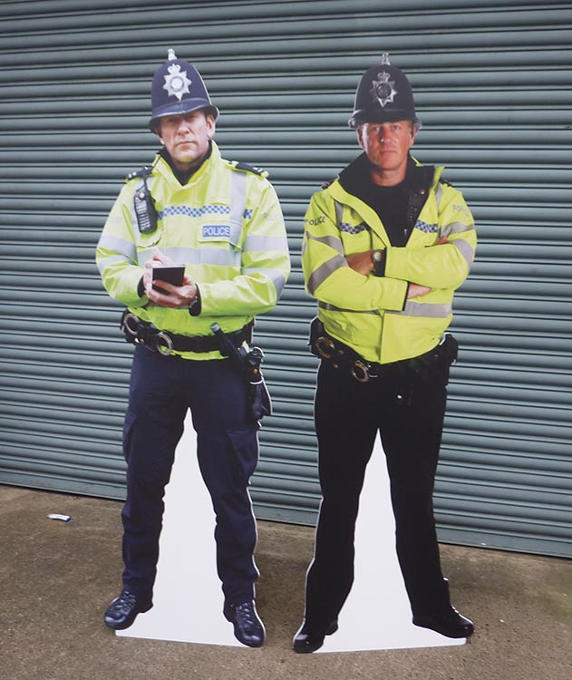

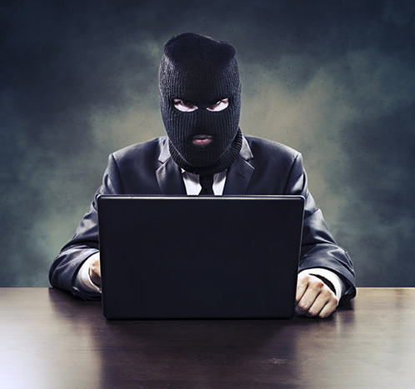
D0 ill3gal Sh1t !

Slide 4
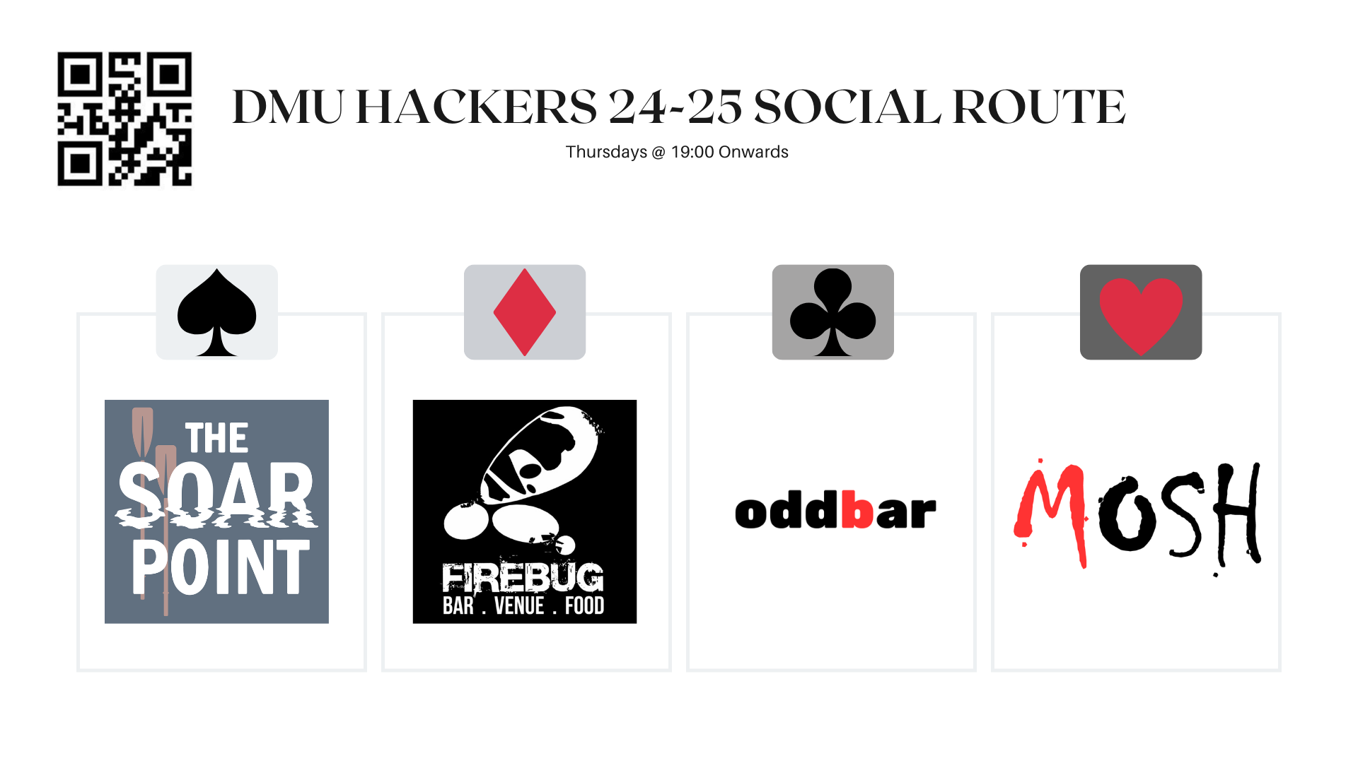
Notes:
Firebug student discount is all week and not just when we go out as a society

Slide 5

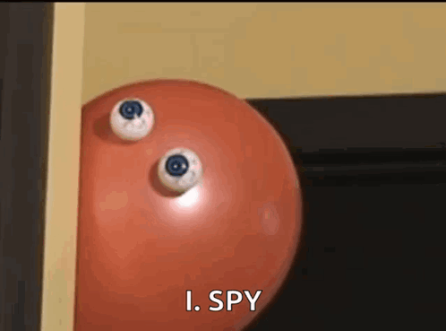
What is PERSEC?

Slide 6
Key Elements of PERSEC:
PII Protection:
Keep sensitive personal information (e.g., full name, address, phone number, date of birth, ID numbers) secure.
Social Media Hygiene:
Limit sharing of personal photos, locations, or future plans (e.g., vacations, deployments).
Use privacy settings to restrict access to personal profiles.
Digital Footprint Management:
Minimize the amount of publicly available information about yourself (e.g., on forums, social media, or public records).
Remove old or unnecessary accounts.
Access Control:
Use strong, unique passwords for accounts and enable multi-factor authentication (MFA).
Lock devices with secure PINs or biometrics.
Communication Security:
Be cautious of phishing emails, phone scams, or unsolicited contacts requesting sensitive details.
Use encrypted messaging and email services when discussing private matters.
Awareness of Surveillance:
Be mindful of physical surveillance (e.g., being followed) or eavesdropping (e.g., phone bugging).

Slide 7
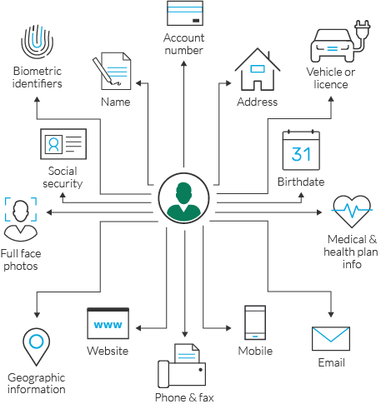
Notes:
PII

Slide 8
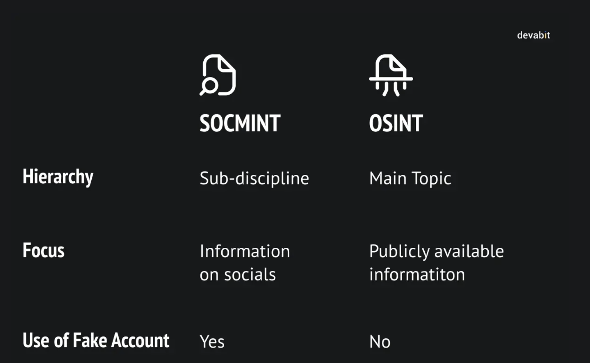
Notes:
Social Media Hygeine - SOCMINT

Slide 9
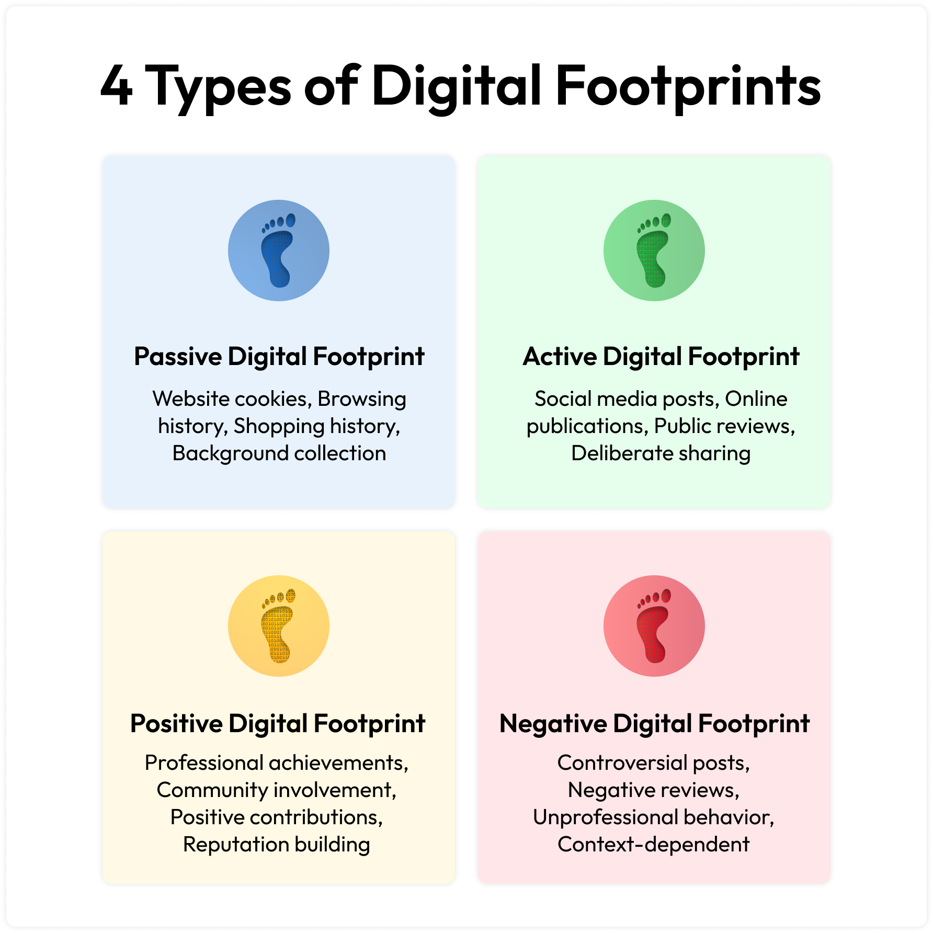
Notes:
Passive - Cookies and browser fingerprint, shopping history and metadata Active - Social media posts, public reviews (Battersea Student accom review)
Positive - LINKEDIN reputational stuff
Negative - Following GBNews

Slide 10
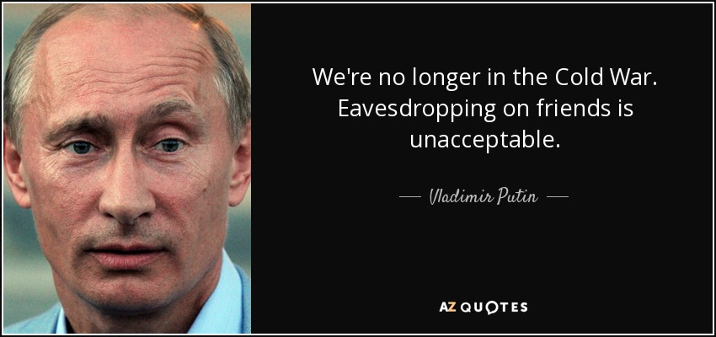
Notes:
Well said vladdy

Slide 11
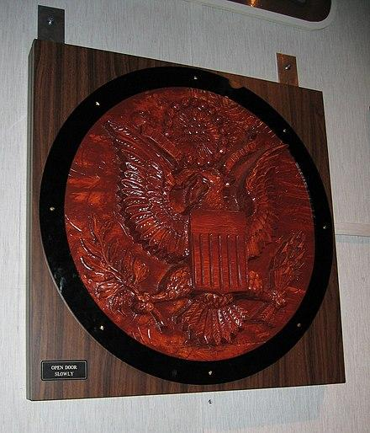
Notes:
The thing… US government gift from Soviets, bugged

Slide 12


What is OPSEC?

Slide 13
OPSEC (Operational Security):
Is a process and strategy used to protect sensitive information and operations from adversaries by identifying and mitigating risks related to information leaks or vulnerabilities. It involves ensuring that critical details about operations, plans, personnel, and systems are not unintentionally revealed, which could be exploited by adversaries.
Notes:
On operations… don’t be a twit and reveal details about the OP over open networks…

Slide 14
Identify Critical Information: Determine what information, if exposed, could jeopardise the operation (e.g., schedules, locations, methods).
Analyse Threats: Understand who the adversaries are, what they seek, and how they might gather information (e.g., surveillance, social engineering).
Assess Vulnerabilities: Identify weaknesses in processes, behaviors, or systems that could lead to information leaks.
Evaluate Risks: Assess the impact of a potential breach and the likelihood of it occurring.
Implement Countermeasures: Apply measures to reduce vulnerabilities, such as:
Limiting access to sensitive information (need-to-know basis).
Encrypting communications.
Conducting regular training on best practices (e.g., avoiding oversharing on social media).
Notes:
What is critical info?
Who is trying to get it?
What vulnerabilities do we have that would cause them to get the info?
What is the risk of this occurring?
Countermeasures to stop them getting it?

Slide 15
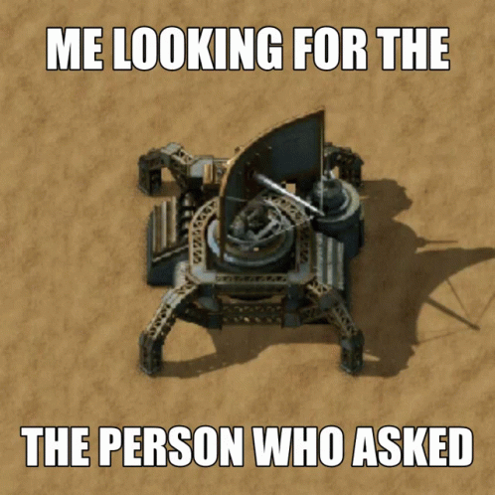

What are SATCOMs?

Slide 16
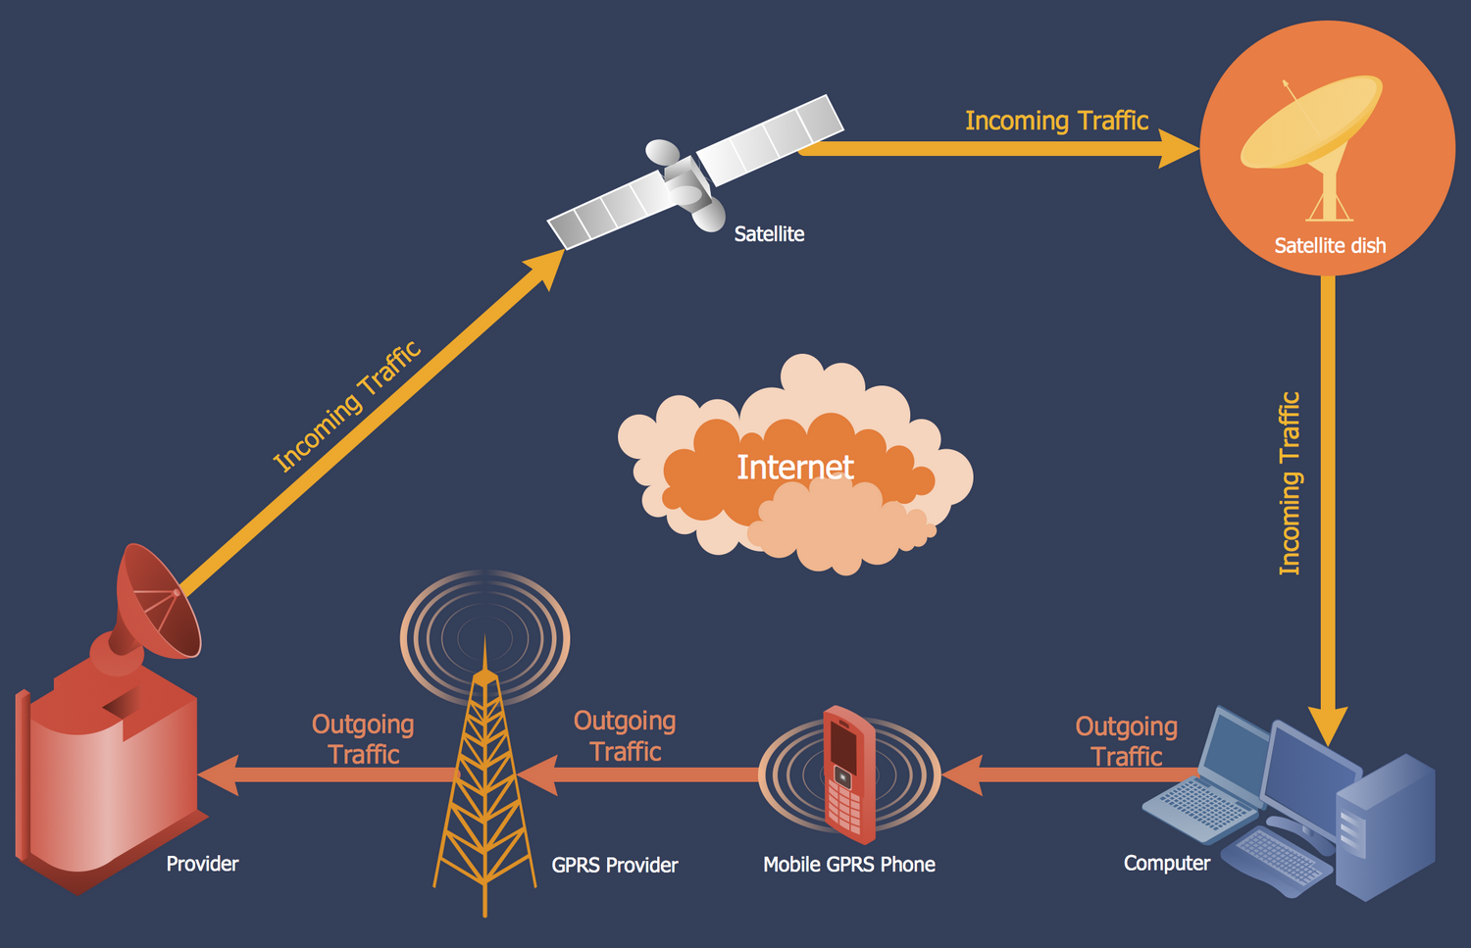
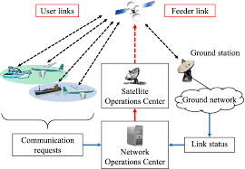
Notes:
Telecoms

Slide 17
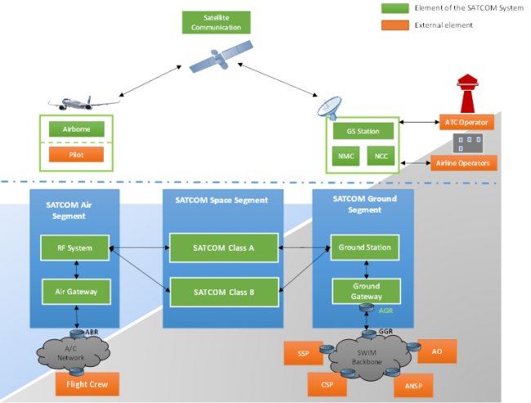
Notes:
Satcoms

Slide 18
How SATCOM Works
Ground Stations: Send and receive signals from satellites.
Uplink: Signals transmitted from the ground station to the satellite.
Satellite Transponder: Amplifies and processes the signal, changing its frequency to avoid interference.
Downlink: Signals transmitted from the satellite to the receiving station or terminal.
End-User Devices: Include satellite phones, antennas, or military communication equipment.

Slide 19
Skynet 5:
Purpose: The Skynet 5 series is a secure military satellite system used by the UK Ministry of Defence (MoD) for strategic and tactical communication.
Launch Period: 2007–2012.
Features:
Geostationary satellites for global coverage.
Secure voice, video, and data communication.
High resistance to jamming and interception.
Managed by Airbus Defence and Space.
Has two UK Downlink sites (YOU DO NOT KNOW THIS INFO)

Slide 20
Geostationary Orbit (GEO): A specific type of geosynchronous orbit where the satellite stays fixed above a single point on the Earth's equator (0° latitude). It has a circular orbit and matches the Earth's rotation exactly (24-hour period). Perfect for communication satellites like SATCOM systems.
Geosynchronous Orbit: A broader category of orbits where the satellite’s orbital period matches the Earth's rotation (24 hours), but it may not stay fixed above one point. These orbits can be inclined or elliptical, causing the satellite to appear to "move" in the sky (e.g., in a figure-eight pattern).

Slide 21
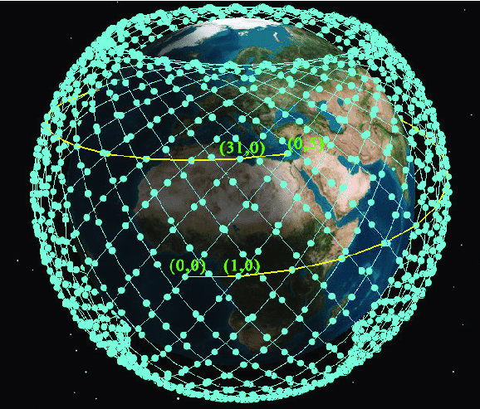
Notes:
This has context… stay with me

Slide 22
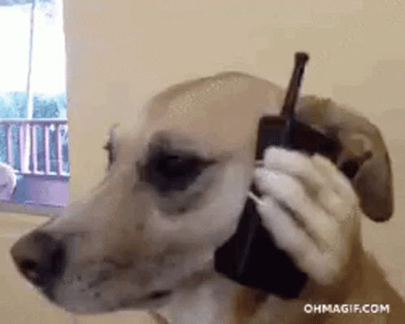
What is SIGINT?

Slide 23
Types of SIGINT:
COMINT (Communications Intelligence):
Focuses on intercepting and analysing communication signals such as phone calls, radio transmissions, or encrypted messages.
Example: Monitoring enemy communications to predict movements or plans.
ELINT (Electronic Intelligence):
Involves capturing and analysing non-communication signals, such as radar or weapons system emissions.
Example: Detecting radar signals from enemy aircraft or missile systems.
FISINT (Foreign Instrumentation Signals Intelligence):
Concerned with intercepting telemetry signals, such as missile tests or satellite communications.

Slide 24
Passive Listening: Using receivers to capture signals from various frequencies (e.g., HF, VHF, UHF bands).
Active Interception: Deploying systems to tap into communication lines or systems.
Satellites: Monitoring global communications and signals via satellite systems.
Ground Stations: Using signal processing equipment to decode or analyze intercepted signals.

Slide 25
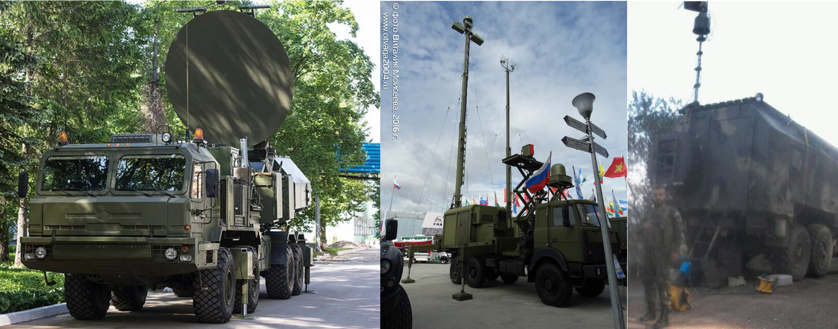

Slide 26
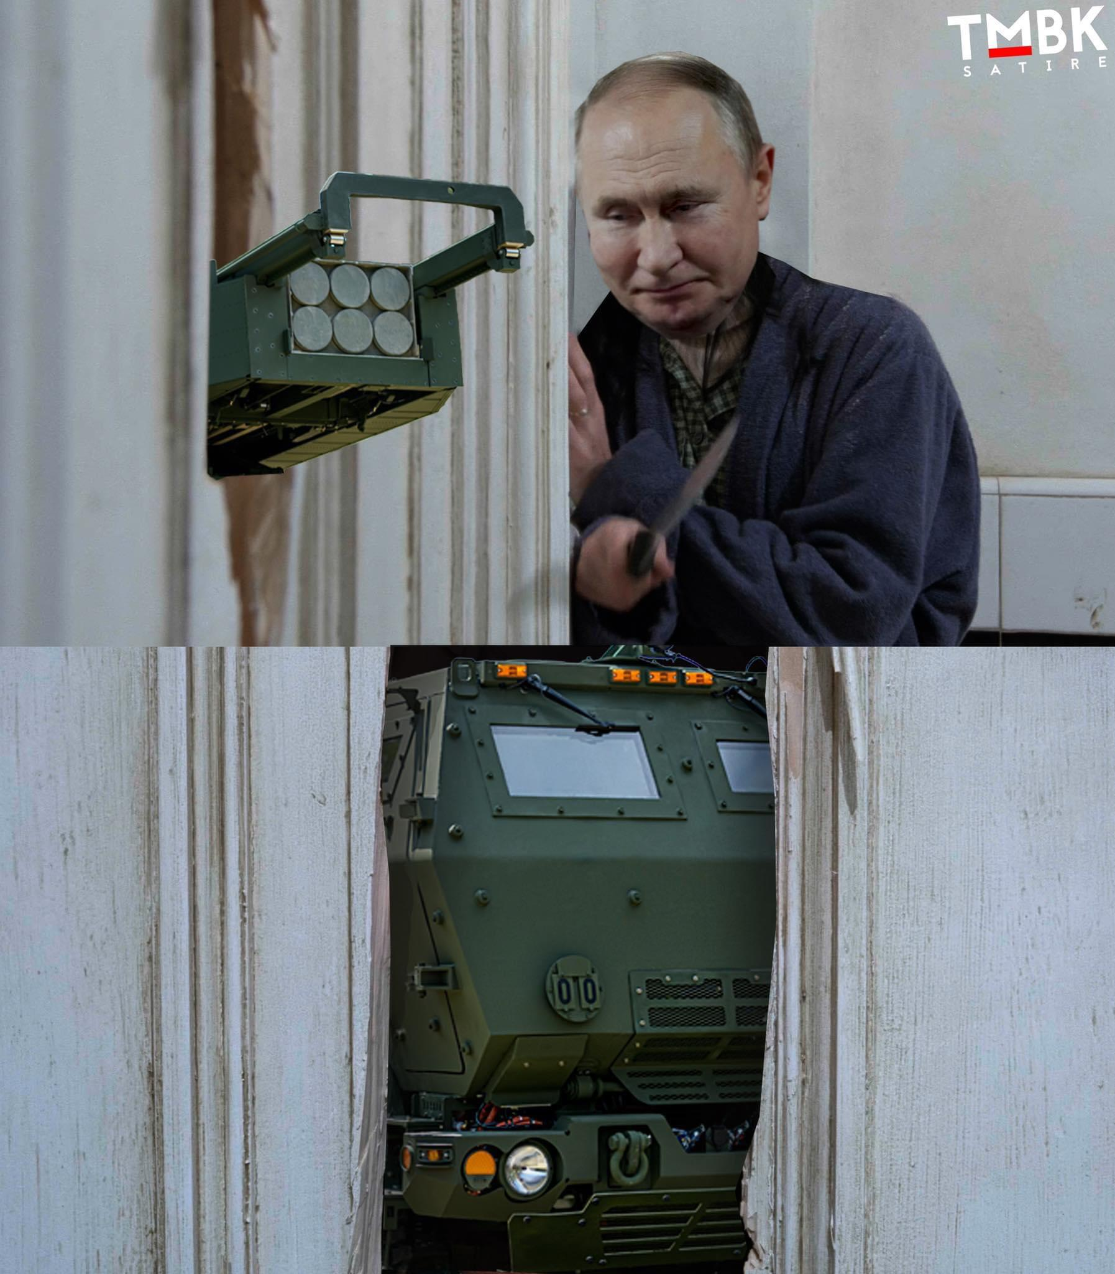
Notes:
Whos at the door… What are the weaknesses of EW Countermeasures, well, HIMARS

Slide 27
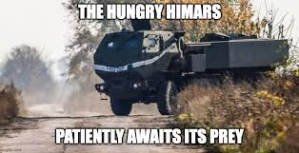

Slide 28
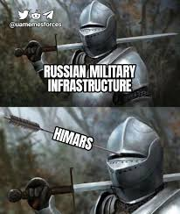

Slide 29
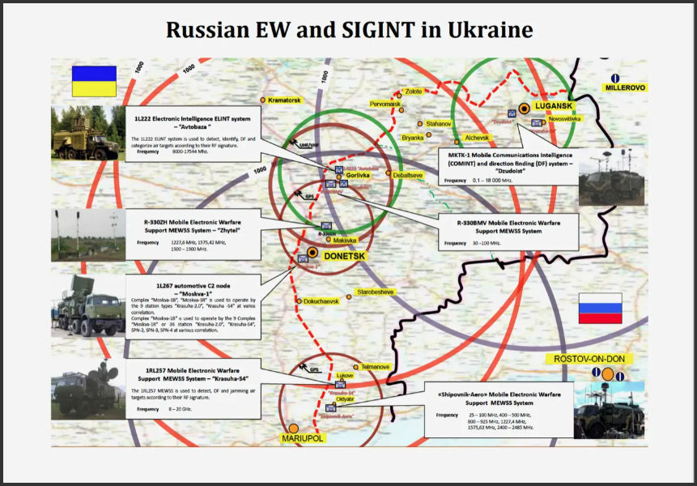
Notes:
Donbas 2016 EW zones

Slide 30
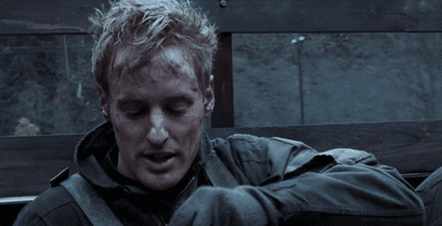
Notes:
SIGINT / OPSEC - NO NAMES ON THE NET STACKHOUSE

Slide 31
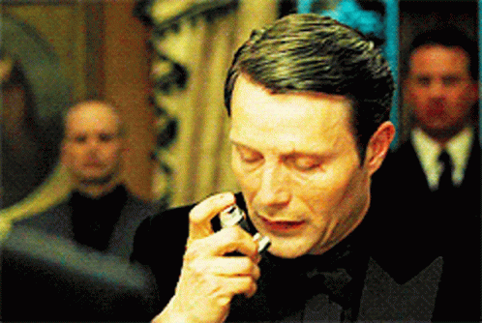
Notes:
PERSEC / OPSEC
James ruins his OPSEC and PERSEC by checking into the hotel with his name - what a stud, but he uses SOCENG to find out who owned the aston martin ;)

Slide 32
Now for the fun bit…
Lets see if you remembered my OSINT talk :)

Slide 33


Slide 34
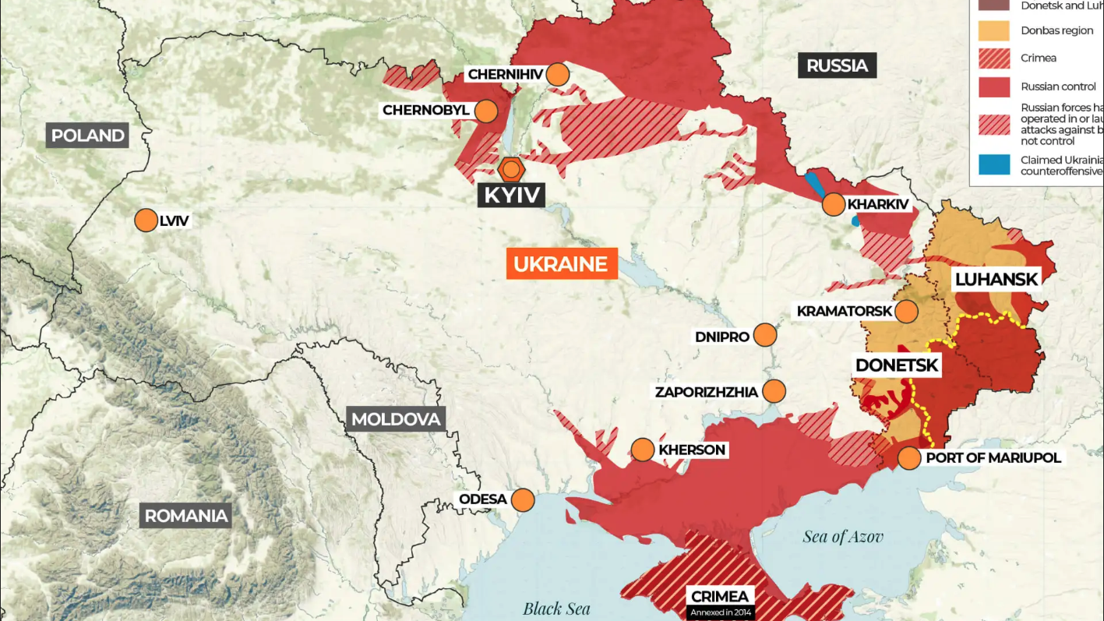

Slide 35
You are a member of the Ukrainian Legion Signals Brigade (18 Sigs), tasked with identifying and disrupting the Russian Offensive in northern Ukraine… Good luck…

Slide 36
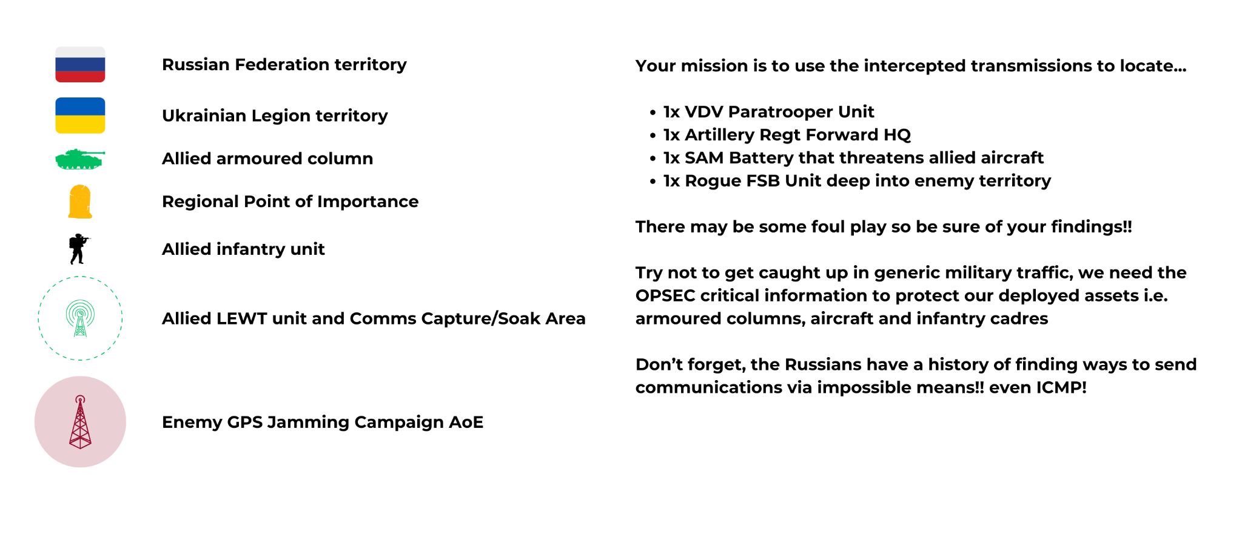

Slide 37
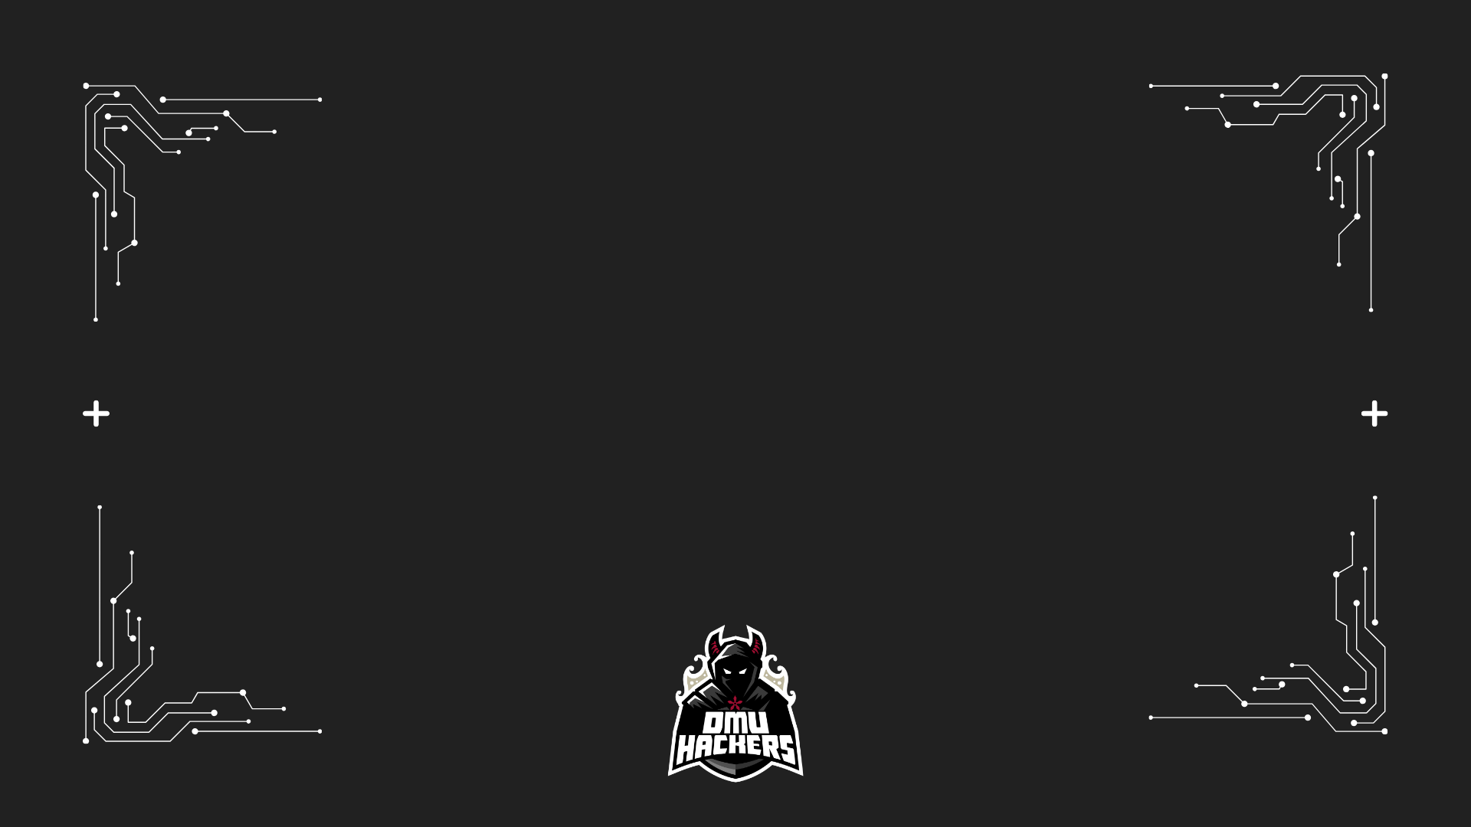


Your turn!

